Slide 1
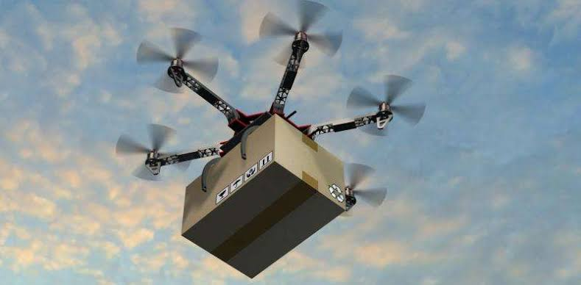
delivery DRONES
GROUP MEMBERS(ASI):
ASJID TAHIR HASSAN SUBHANI IBRAR BABAR

Slide 2
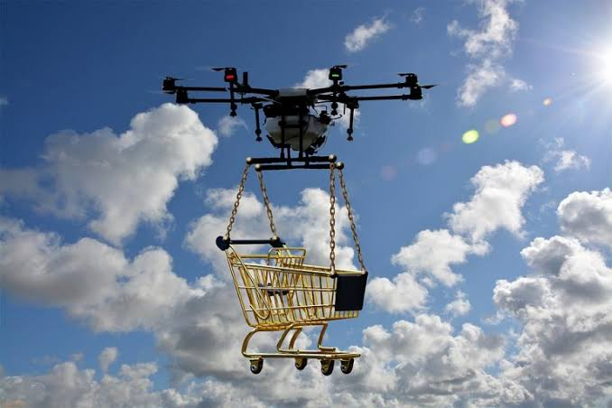
WHAT ARE DELIVERY DRONES ???
A delivery drone is an autonomous vehicle often a UAV used to transport Packages ,Food
and other goods.
Remotely or autonomously
controlled.

Slide 3
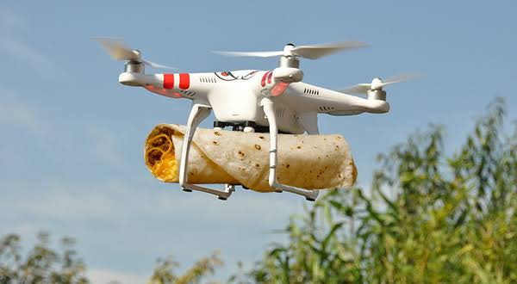
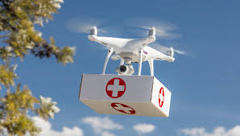
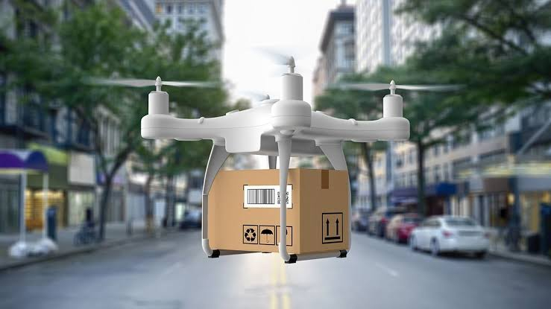
Types of Deliveries:
Health care.
Food care
Postal care.

Slide 4
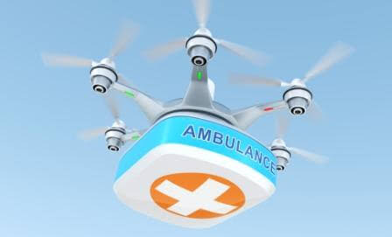
Health care:
Delivery drones are used to give any cure , treatment to other person by first aid box.
They are used to give medicines.

Slide 5
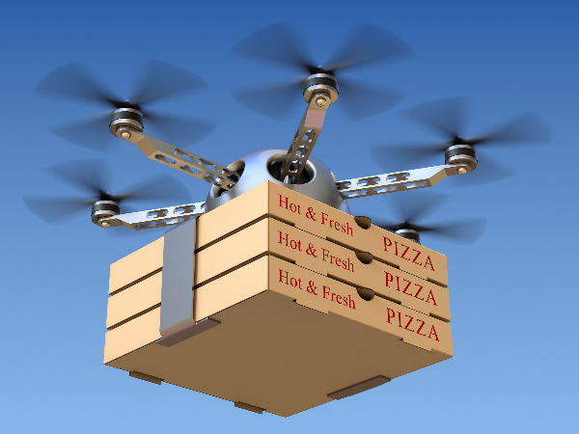
Food Care:
They are used to deliever food products :
Pizzas
Paratha Roll
Burgers
Shwarmas.

Slide 6
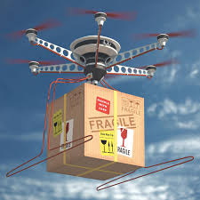
Postal care:
They are used to deliever any type of gadgets such as :
Boxes.
Parcels.

Slide 7
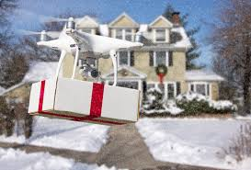
Working Of delivery drones:
A tilting design allows for the drone to use the same six propellers to fly forward as it does for take off and landing. Packages for delivery are then carried in the fuselage in the middle.

Slide 8
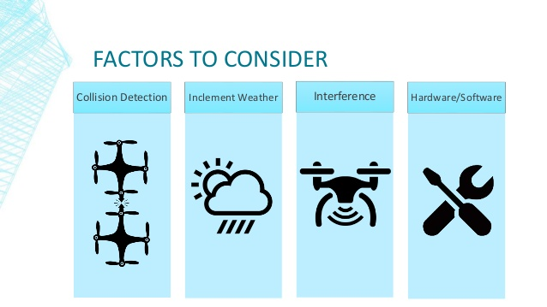

Slide 9
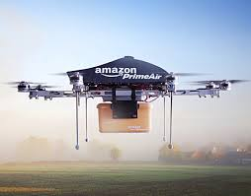
EXPERIMENT:
BY AMAZON
Amazon has said it will use drones
to deliver packages to customers.
TIME: 30 minutes maximum.
Cost : $0.40

Slide 10
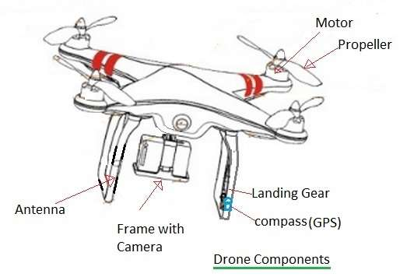
COMPONENTs:
Remote
A receiver
Processing unit
Battery
Motor
Gyroscope
Acutator.
GPS
Camera (optional))

Slide 11
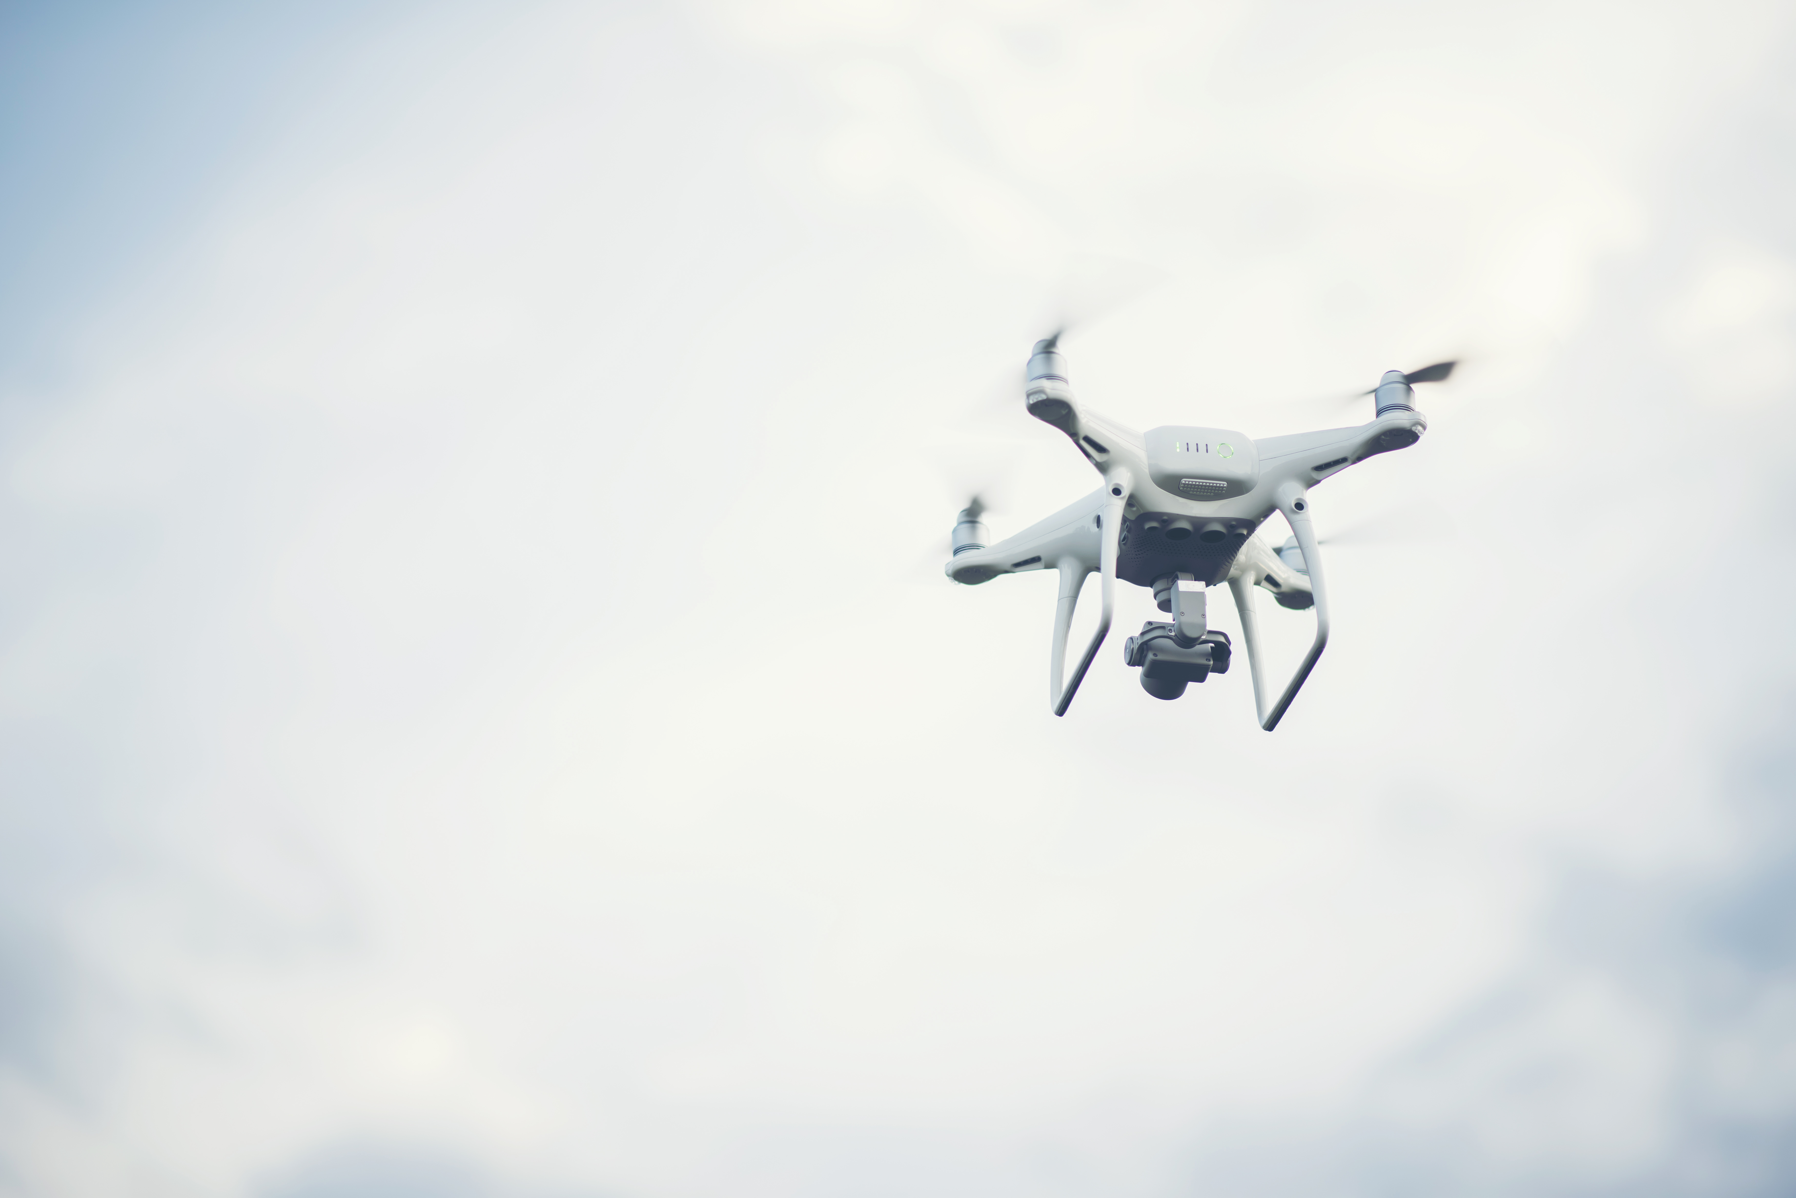
Advantages:
Shorter routes
Saving of Time
Enviromental friendly
No human involvement
Helps in shooting (sports,military,wildlife)
Can be used in dangerous enviroments.

Slide 12
Disadvantages:
Deliveries must be less then 15lbs

Slide 13
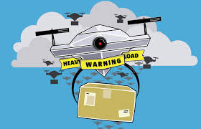
Safety precautions:
Heavy Load.
Batteries properly charged
Correct GPS location
String should be strong enough

Slide 14


Slide 15


